Slide 1

Cars data
Analysis of cars sale during 2019

Slide 2

Questions
1. How many cars were offered in 2019?
2. How many cars are there that were offered for sale by age (i.e., the difference between the year of sale and the model year)? How many cars are offered that are older than 10 year
3. How many cars does each manufacturer sell?
4. Do manufacturers produce more cars with large engines, or more with smaller engines? Is there a relationship here between engine displacement and the model year of the c
5. What is the relationship between average fuel consumption and engine displacement? Which car has the largest engine displacement? What is its average combustion? Which car is the most economical?
6. Does the price of a car depend on its horsepower? What horsepower does the most powerful car offered have?
7. Is there a relationship between the range of the car and its total weight? The air resistance that the car can put up (hint: it may depend on the height of the car)?
8. Which manufacturer has the highest average retail price (msrp) for their cars?
9. Which manufacturer offers a longer basic warranty (basic_years) for their cars?
10. What is the average horsepower (net_horsepower) for cars with automatic transmission, and how does it compare to cars with manual transmission?
11. What is the most common type of drivetrain among the cars sold in 2019?
12. How does the average net horsepower vary across different categories of cars?

Slide 3
Null_values
Value assignment x marking to have missing values
When calculating numerical data – „0“ value excluded (in cases when „0“ means „missing data“) – in table shown as „blank field“
The same approach with categorical variables
Logic for adding missing data:
Model name basic based on function !textbefore! And !textafter! From column model_year
Category based on information in Model name; for example: hatchback, Sedan, Coupe = CAR, what had been missing - googled based on the model name basic
msrp based on average of Model name basic + model year
mpg based on average of Model name basic (electric engines excluded) > 2793 still "0"
fuel tank capacity based on average of Model name basic (electric engines excluded) > 15481 with "0"
range of the car MGP*fuel tank capacity; excluded Electric engines but still 17370 with "0" vaule
Electric cars mpg + displacement + fuel tank capacity > blank spaces=0
trans_type based on the model name; what not celar > undefined
basic_years based on the average basic years for model name basic
displacement based on the average basic years for model name basic
net torque based on the average basic years for model name basic
horsepower based on the average basic years for model name basic

Slide 4
EDA – numerical statistics interpretation 1/3
STATISTICS | model_year | age_of_the_car | msrp
minimum value | 1990 | 0,0 | $ 6 929,00
maximum value | 2019 | 29,0 | $ 548 800,00
mean | 2009,5 | 9,5 | $ 37 749,10
median | 2011 | 8,0 | $ 30 560,00
standard deviation | 7,2 | 7,2 | $ 32 523,98
75th percentile | 2015 | 14,0 | $ 40 782,50
MODEL YEAR
The distribution of manufacturing years is relatively extensive, ranging from a minimum of 1990 to a maximum of 2019.
The close proximity of the mean (2009.5) and median (2011) suggests a symmetric distribution with a slight influence of outliers. The mean and median suggest that, on average, the cars sold in 2019 are from around the year 2009 or 2011, respectively.
With a standard deviation of 7.2, there is variability around the mean, and the 75th percentile falls on the year 2015, indicating a significant proportion of recent model years.
Right skeweness - mean > median > mode >>> here are more below-average results in the sample
Age of the car
The dataset describes the age of cars, ranging from 0 to 29 years.
The mean age of the cars is 9.5 years, suggesting that, on average, the cars in the dataset are relatively mature. The median age, at 8 years, is lower than the mean, indicating a slightly right-skewed distribution, possibly influenced by some older cars.
The standard deviation of 7.2 implies a notable degree of variability in car ages around the mean, reflecting a diverse range of ages within the dataset.
Additionally, the 75th percentile at 14 years suggests that a substantial portion of the cars are relatively aged, contributing to the dataset's overall dispersion.
MSRP
The dataset reveals a wide range of Manufacturer's Suggested Retail Prices (MSRP) for cars, spanning from $6,929 to $548,800.
The mean MSRP of $37,749.10 and the median of $30,560.00 suggest a right-skewed distribution, indicating that while the majority of cars are priced below the mean, there are some with substantially higher prices pulling the average upwards.
The high standard deviation of $32,523.98 emphasizes the significant variability in car prices around the mean, highlighting the diverse pricing landscape in the dataset.
The 75th percentile at $40,782.50 provides an upper quartile boundary, indicating that a substantial portion of the cars are priced below this value, but a notable proportion commands higher prices.

Slide 5
EDA – numerical statistics interpretation 2/3
STATISTICS | mpg | base_curb_weight | height | fuel_tank_capacity
minimum value | 9,0 | 1808,0 | 44,3 | 0,0
maximum value | 61,0 | 8591,0 | 110,1 | 48,0
mean | 19,5 | 3610,2 | 66,4 | 21,7
median | 18,4 | 3497,0 | 67,5 | 19,5
standard deviation | 5,5 | 695,2 | 9,4 | 7,2
75th percentile | 22,0 | 4048,0 | 74,4 | 26,0
MPG
The data on miles per gallon (mpg) shows a wide range from 0 to 61.
With a mean of 19.5 and a median of 18.4 - a right-skewed distribution - suggests that while the majority of cars have relatively higher fuel efficiency, there are some vehicles with significantly lower mpg values, contributing to the extended right tail in the distribution.
The high standard deviation of 5.5 indicates significant variability in fuel efficiency.
The lower 75th quartile at 22.0 suggests that a substantial number of cars have relatively higher fuel efficiency, but the spread of data, as shown by the standard deviation, implies a diversity of mpg values among the vehicles.

Slide 6
EDA – numerical statistics interpretation 3/3
STATISTICS | range_of_the_car | basic_years | displacement | net_torque | net_horsepower
minimum value | 187,2 | 2,0 | 0,7 | 65,0 | 65,0
maximum value | 913,8 | 6,0 | 7,5 | 935,0 | 808,0
mean | 367,7 | 3,4 | 3,5183 | 267,0 | 256,4
median | 359,6 | 3,0 | 3,5000 | 258,0 | 250,0
standard deviation | 66,9 | 0,7 | 1,39 | 102,2 | 98,0
75th percentile | 399,0 | 4,0 | 4,6 | 333,5 | 305,0

Slide 7
1. How many cars were offered in 2019?
Age of the car | Count of car_id
0 | 2431
1 | 2801
3 | 2225
4 | 2103
5 | 1897
6 | 1898
7 | 1870
8 | 1671
9 | 1456
10 | 1437
11 | 1382
12 | 1294
13 | 1192
14 | 1116
15 | 1034
16 | 848
17 | 753
18 | 732
19 | 586
20 | 543
21 | 471
22 | 469
23 | 391
24 | 385
25 | 298
26 | 251
27 | 286
28 | 261
29 | 235
Grand Total | 32316
Age of the car | Count of car_id
11 | 1382
12 | 1294
13 | 1192
14 | 1116
15 | 1034
16 | 848
17 | 753
18 | 732
19 | 586
20 | 543
21 | 471
22 | 469
23 | 391
24 | 385
25 | 298
26 | 251
27 | 286
28 | 261
29 | 235
Grand Total | 12527
32316
2. How many cars are there that were offered for sale by age (i.e., the difference between the year of sale and the model year)? How many cars are offered that are older than 10 years?

Slide 8
3. How many cars does each manufacturer sell?
Manufacturer | Count of car_id
Acura | 318
Alfa Romeo | 45
Aston Martin | 53
Audi | 1183
Bentley | 83
BMW | 1283
Buick | 359
Cadillac | 558
Dodge | 480
Ferrari | 7
Fiat | 124
Ford | 4186
Genesis | 29
GMC | 2066
Honda | 1746
Hyundai | 1017
Chevrolet | 2977
Chrysler | 183
Infiniti | 192
Jaguar | 393
Jeep | 778
Kia | 747
Lamborghini | 39
Land Rover | 290
Lexus | 263
Lincoln | 283
Lotus | 18
Maserati | 129
Mazda | 779
McLaren | 11
Mercedes-Benz | 955
Mini | 101
Mitsubishi | 301
Nissan | 2238
Porsche | 563
Ram | 1032
Rolls-Royce | 63
Smart | 51
Subaru | 1504
Tesla | 67
Toyota | 2739
Volkswagen | 1565
Volvo | 518
Grand Total | 32316

Slide 9
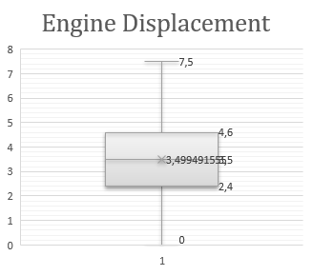
4. Do manufacturers produce more cars with large engines, or more with smaller engines? Is there a relationship here between engine displacement and the model year of the car?
ENGINE | Count of displacement | Average of displacement
V12 | 208 | 6,19
W12 | 65 | 6,02
V8 | 8611 | 5,37
V10 | 41 | 5,37
W8 | 8 | 4,00
V6 | 8596 | 3,53
I6 | 554 | 3,29
Undefined | 1969 | 3,15
l6 | 263 | 3,02
l5 | 530 | 2,82
Flat | 1206 | 2,79
l4 | 9973 | 2,08
l3 | 112 | 1,17
Electric | 180 | 0,03
Grand Total | 32316 | 3,50
Q1 | 0-2,4
Q2 | 2,4-3,5
Q3 | 3,5-4,6
Q4 | 4,6-7
average | 3,449
mean | 3,5
stdv | 1,41
mode | 2
The fact that Q2 (the median) is around 3.5 suggests that half of the cars in dataset have engine displacements below this value, and half have displacements above it.
To summarize, data indicates a relatively even spread of engine displacements, with a median around 3.5 and the majority of values falling within the interquartile range (Q1 to Q3). This supports interpretation that manufacturers produce cars with a mix of engine sizes.
The standard deviation of 1.41 indicates that the data points are dispersed around the mean.

Slide 10
PEARSON -0,029139693 >> perfect anti-correlation. Change in one variable corresponds to a change in the other variable in the opposit direction

Slide 11
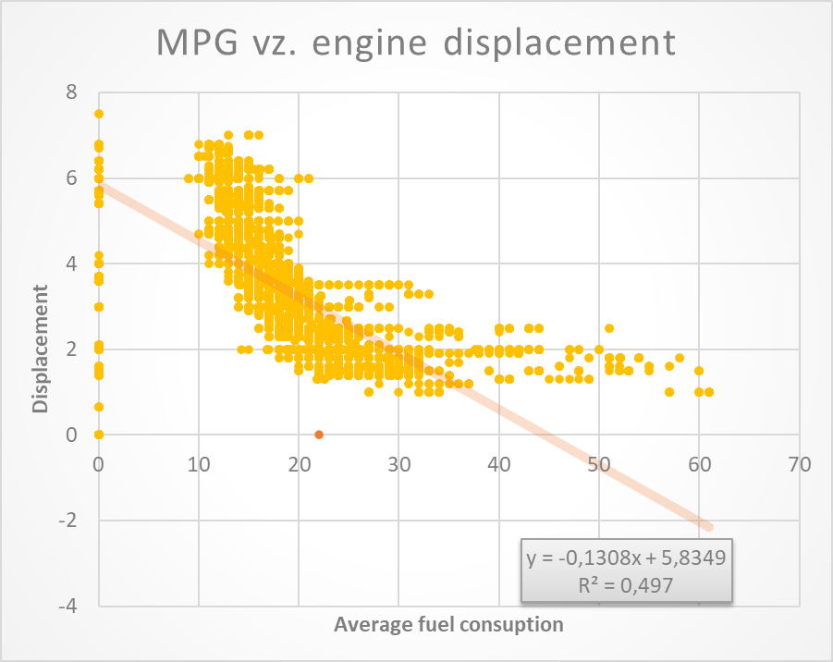
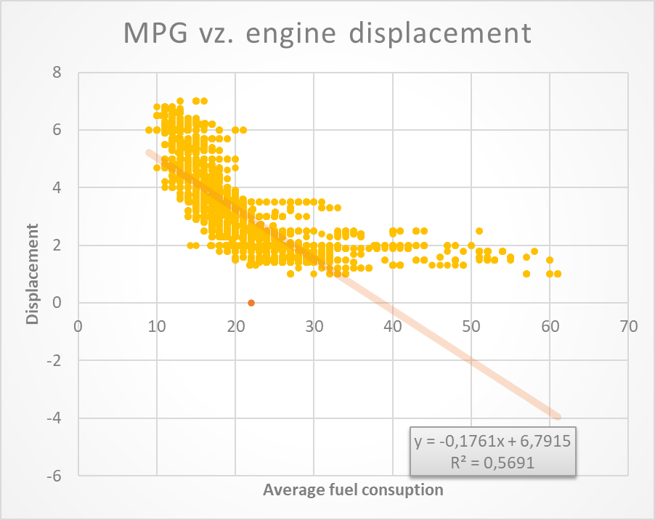
5. What is the relationship between average fuel consumption and engine displacement? Which car has the largest engine displacement? What is its average combustion? Which car is the most economical?

Slide 12
Car model - basic name | Max of displacement | Average of mpg | Average of range_of_the_car
Ford Super Duty F-250 Specs | 7,50 | 0,00 | 0,00
Chevrolet Camaro Specs | 7,00 | 16,98 | 329,34
Chevrolet Corvette Specs | 7,00 | 16,07 | 299,36
Rolls-Royce Cullinan Specs | 6,80 | 12,00 | 0,00
Bentley Mulsanne Specs | 6,80 | 10,92 | 276,55
Rolls-Royce Phantom Specs | 6,80 | 11,32 | 0,00
Bentley Continental GT Specs | 6,75 | 11,72 | 281,59
GMC Savana Passenger Specs | 6,60 | 12,51 | 387,70
Rolls-Royce Dawn Specs | 6,60 | 12,00 | 0,00
Chevrolet Express Passenger Specs | 6,60 | 12,17 | 377,17
BMW 7-Series Specs | 6,60 | 16,25 | 345,47
Rolls-Royce Wraith Specs | 6,60 | 12,60 | 0,00
Rolls-Royce Ghost Specs | 6,60 | 12,75 | 0,00
Ferrari 812 Superfast Specs | 6,50 | 12,00 | 291,60
Lamborghini Aventador Specs | 6,50 | 10,57 | 0,00
Jeep Grand Cherokee Specs | 6,40 | 16,14 | 0,00
Dodge Charger Specs | 6,40 | 16,40 | 311,10
Ram 2500 Specs | 6,40 | 0,00 | 0,00
Chrysler 300 Specs | 6,40 | 17,46 | 329,22
Dodge Durango Specs | 6,40 | 15,49 | 391,43
Dodge Challenger Specs | 6,40 | 15,56 | 293,66
Grand Total | 7,50 | 9,38 | 169,47
Which car has the largest engine displacement? |  |  | Ford Super Duty F-250 Specs
What is its average combustion? |  |  | Missing data BUT based on the MPG of all Ford cars with engine V8 we can apporximate average MPG of our car at 14,62
Which car is the most economical? |  |  | Fuel efficient car - Electric cars /Hybrid cars in general
PEARSON | -0,704981376 | >> perfect anti-correlation
R2 | 0,497 | >> lack of relationship

Slide 13
6. Does the price of a car depend on its horsepower? What horsepower does the most powerful car offered have?
Pearson 0,670352262
2018 Dodge Challenger Specs: SRT Demon RWD 808,0

Slide 14
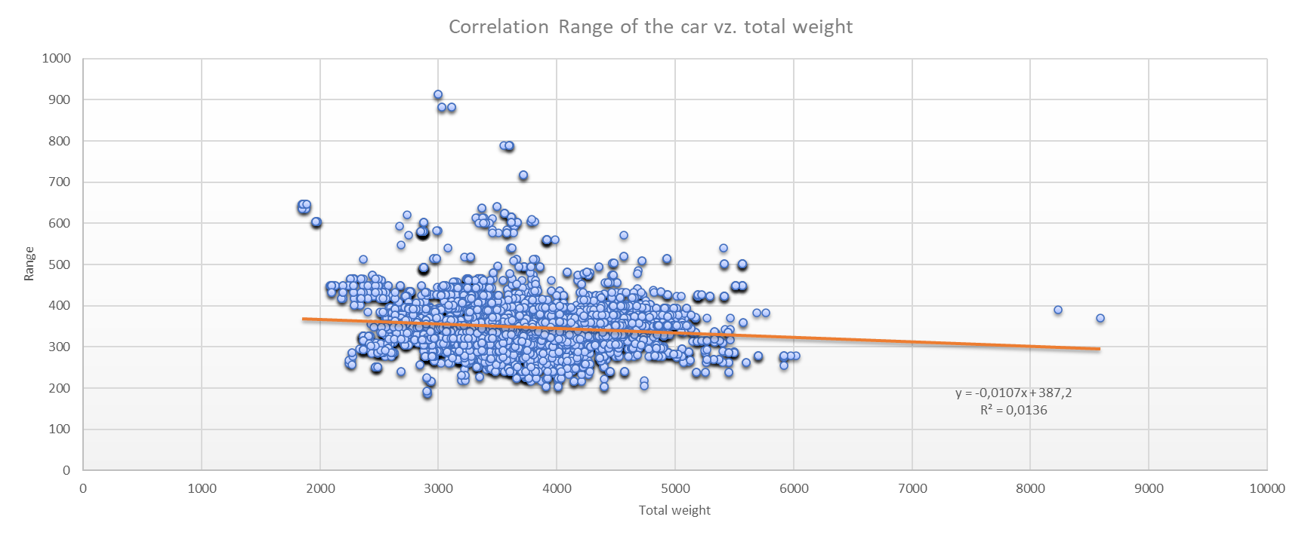
7. Is there a relationship between the range of the car and its total weight? The air resistance that the car can put up (hint: it may depend on the height of the car)?
PEARSON | 0,040483331 | >> no statistical linear correlation. A change in one variable does not affect the change in the other variable
R2 | 0,0136 | >> perfect lack of relationship

Slide 15
8. Which manufacturer has the highest average retail price (msrp) for their cars?
Manufacturer | Average of msrp
Rolls-Royce | $376 598,10
Lamborghini | $359 753,12
Ferrari | $273 879,00
McLaren | $251 540,00
Bentley | $239 821,38
Aston Martin | $216 396,98
Maserati | $116 850,05
Porsche | $99 033,94
Tesla | $88 786,57
Lotus | $74 140,00
Mercedes-Benz | $73 704,81
Land Rover | $70 484,67
Jaguar | $69 830,79
Cadillac | $57 647,64
BMW | $56 878,67
Lexus | $56 630,87
Genesis | $55 503,45
Acura | $48 929,22
Lincoln | $48 619,74
Infiniti | $48 017,58
Grand Total | $76 808,10
9. Which manufacturer offers a longer basic warranty (basic_years) for their cars?
Manufaturer | Max of basic_years
Volkswagen | 6
Cadillac | 6
Mitsubishi | 5
Hyundai | 5
Nissan | 5
Genesis | 5
Kia | 5
Jaguar | 5
Grand Total | 6
10. What is the average horsepower (net_horsepower) for cars with automatic transmission, and how does it compare to cars with manual transmission?
Transmission | Average of horsepower | Count of car_id
Automatic | 269,9 | 19666
CVT | 177,1 | 1596
Manual | 243,0 | 9788
Undefined | 249,5 | 1266
Grand Total | 256,4 | 32316
11. What is the most common type of drivetrain among the cars sold in 2019?
Row Labels | Count of car_id
4WD | 6702
AWD | 5987
FWD | 9231
RWD | 9160
Undefined | 1236
Grand Total | 32316
12. How does the average net horsepower vary across different categories of cars?
Car category | Average of net_horsepower | Count of car_id
Car | 241,0 | 14990
Pickup | 289,0 | 7949
SUV | 253,1 | 8072
Van | 255,3 | 1305
Grand Total | 256,4 | 32316

